Slide 1

Women’s Security (SecureHer)
Presented by
2005009
2005010
2005011
2005014
2005022
2005025
1

Slide 2
Introduction
SecureHer is a system focused on improving women's safety through real-time tracking, emergency SOS alerts, and community-based features. It provides quick access to local resources, secure communication, and NGO involvement for comprehensive support.
2

Slide 3
Challenges
Lack of immediate response during emergencies.
Limited knowledge of unsafe areas.
Difficulty accessing nearby safety resources.
Absence of secure communication methods.
Weak integration with NGOs and individual support systems.

Slide 4

Motivation
Address the rising need for women’s security through technology.
Provide a comprehensive platform combining real-time tracking, emergency alerts, and community collaboration.
Foster partnerships with NGOs and individuals for broader support and engagement.
3

Slide 5
Subsystems
4

Slide 6
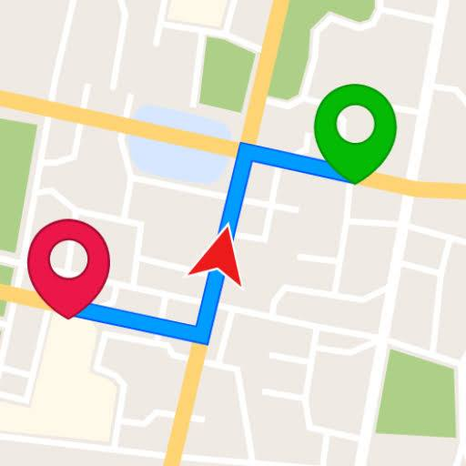
Real-time Location Tracking
Tracks user’s location in real time with video and photo evidence for emergencies.
Enables trusted contacts to monitor location for immediate safety verification.
5

Slide 7

Emergency SOS Alerts:
Sends instant alerts to trusted contacts with real-time location and distress signal.
Auto-notifies local authorities or NGOs for rapid assistance.
6

Slide 8
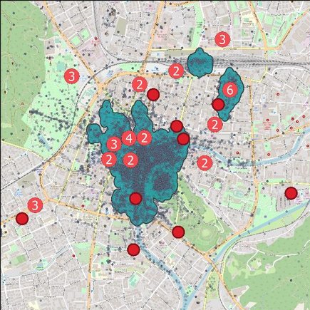
Unsafe Area Reporting
Based on user reports, unsafe areas will be displayed on an administrative dashboard.
Provides heatmaps and reviews to highlight high-risk zones on a live map.
7

Slide 9

Access to Local Resources
Displays nearby police stations, support centers, and NGO locations for quick access.
Includes direct contact details and navigation to the nearest safe location.
8

Slide 10

Safe Communication System
Secure messaging system with end-to-end encryption for privacy.
8

Slide 11
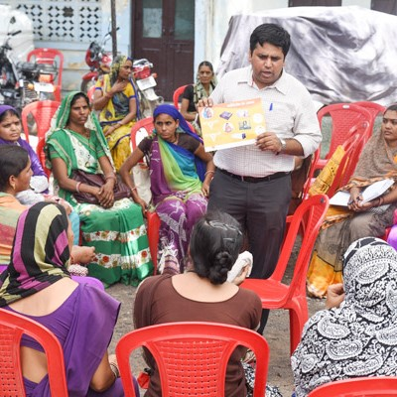
Community Engagement Platform
Users can share safety tips, stories, and raise awareness on women’s safety issues.
Includes forums for local discussions on safety concerns and preventive measures.
8

Slide 12
Scope
Women of all ages seeking enhanced personal safety.
NGOs, local authorities and volunteers involved in women's protection and support.
9

Slide 13
Conclusion
SecureHer offers an all-in-one solution to enhance women’s safety.
Combines tracking, community input, NGO support, and communication tools.
Empowers women to proactively ensure their own safety and well-being.
10

Slide 14
Thank You
11

